Slide 1
ECE-GY 6143 Final Project - Fall 2020:
Generating Images Through Sketch RNN
Neeraja Narayanswamy, nn2108
Sahil Makwane, sm9127

Slide 2
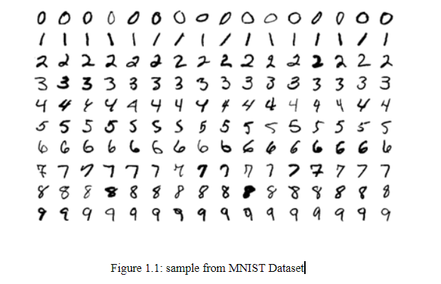
A Brief overview of the concepts
The MNIST Dataset

Slide 3
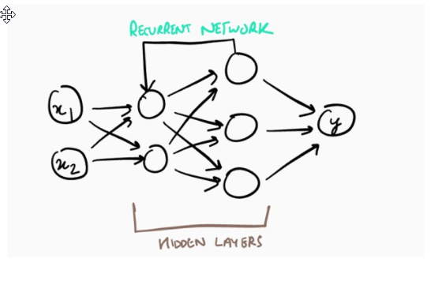
A Brief overview of the concepts
Recurrent Neural Networks

Slide 4
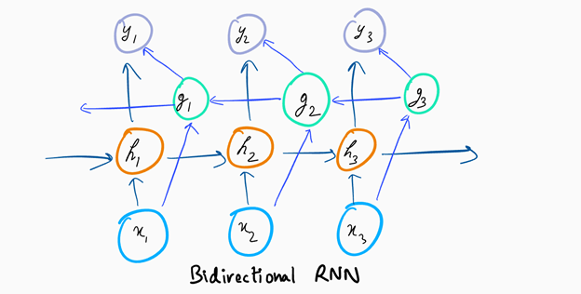
A Brief overview of the concepts
Bi Directional RNNs

Slide 5
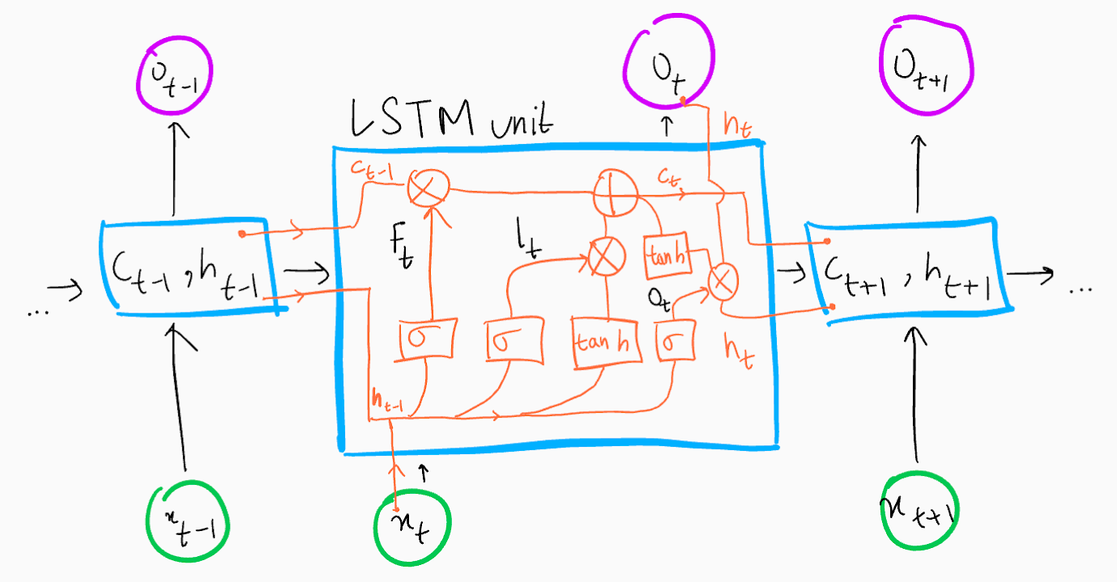
A Brief overview of the concepts
Long Short Term Memory Networks

Slide 6
Sketch RNN
What is Sketch RNN
Encoder - Bi directional RNN, Decoder - Auto Regressive RNN
Structure of Sketch RNN
Loss Function:
Why Did we choose Sketch RNN

Slide 7
Methodology
Loading the data
Training the Data
Running the Notebook
Mario Bonse Notebook

Slide 8

Results & Conclusion

Slide 9
Results & Conclusion

Slide 10
Results & Conclusion
Sketch RNN can be used to generate handwritten Images
It can be used in NLP
It can be used to improve NLP

Slide 11
Future Work
Generating aesthetic looking sketches out of bad drawings
The MNIST handwriting model can assist kids in learning how to write numbers
By incorporating user feedback we can make the model perform exponentially better over-time

